Slide 1
DEPARTMENT OF COMPUTER SCIENCE AND ENGINEERING

Slide 2
AIDA- The Virtual Voice Assistant
Team Members:
Abhin Jose
Asif Ali Najeeb
Diya Ajithkumar
Jasna Sara John
Guide:
Sooraj T R
Head of the Department
Computer Science and Engg.

Slide 3
ABSTRACT
“AIDA” is an AI-based virtual assistant that operates via text and voice commands for windows-based systems.
It helps with day-to-day activities like searching in Wikipedia, searching for videos, live weather conditions, translations, searching for news.
Operating on the foundations of machine learning and artificial intelligence, it is capable of understanding user preferences, likes, dislikes, and habits over time.
Unlike existing systems, AIDA provides a chatbot system, opens/closes apps, sets alarms and remainders and more.
More commands or functions to provide new services can be added in future updates.
AIDA simplifies communication with a computer system.

Slide 4
PROPOSED SYSTEM
Existing virtual assistant systems collect all kinds of personal data like email content, location, communication history and more. AIDA clears communication history after each conversation and asks permission before accessing any personal data.
AIDA has fast response to voice commands whilst most of the systems already built are really slow and time consuming.
The existing systems use ANN(Artificial Neural Network) which is time consuming algorithm having only basic properties whereas AIDA uses RNN(Recurrent Neural Network) which has advanced features and is more reliable.
Most of the built systems cannot access the calendar to create to-do lists or appointments but AIDA can.
Some systems are active even in the sleep mode of device which means they listen even when the PC is locked. AIDA ensures the user’s privacy and activates only when the device is unlocked.

Slide 5
REQUIREMENT SPECIFICATIONS
Hardware Requirements
Processor: Intel Core i3 or above, Ryzen 3 or above.
Hard Disk Size: 6 GB
Memory Size: 2 GB or Above
Architecture : 32bit or 64bit
Software Requirements
Operating system: Windows 8 or above, Linux
Language: Python 3.5

Slide 6
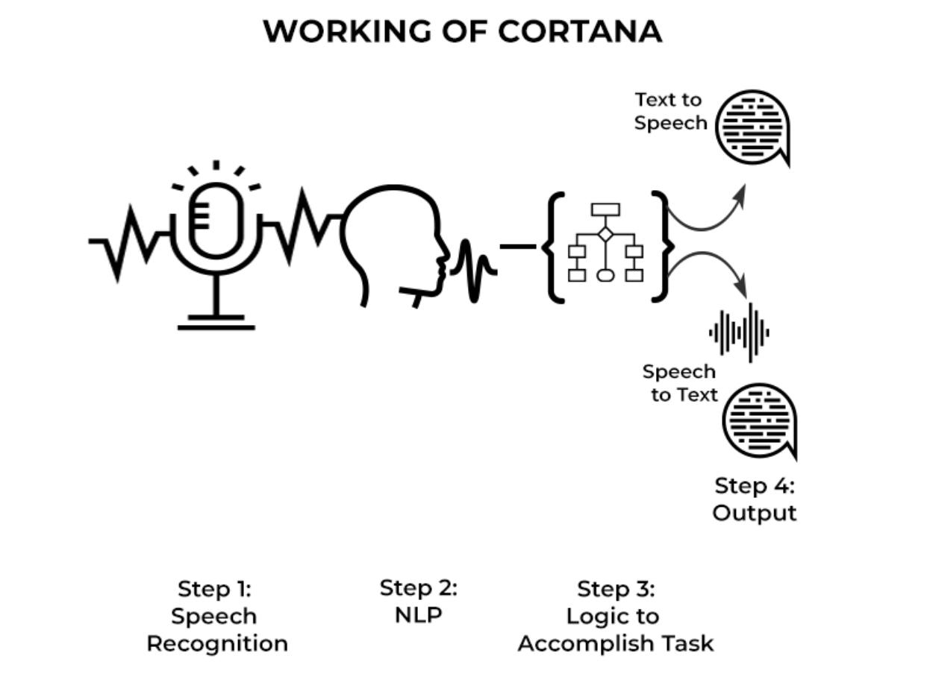
SYSTEM ARCHITECTURES
USER
COMMANDS
BASIC SYSTEM CONTROLS
OPEN COMMON WEBSITES
SEND MESSAGES IN WHATSAPP
SEARCH PLACES ON MAP
SEARCH IN WIKIPEDIA
NEWS HEADLINES
JOKES
PLAY AUDIOS AND VIDEOS
WRITE NOTES
TELL TIME
CHATBOT
WORKNG OF AIDA

Slide 7
REFERENCES
Websites and papers referred –
"Virtual Voice Assistant In Python (Friday)," 2022 IEEE 4th International Conference on Cybernetics, Cognition and Machine Learning Applications (ICCCMLA), Goa, India, 2022
https://ieeexplore.ieee.org/stamp/stamp.jsp?tp=&arnumber=9989099&isnumber=9988754
"An Intelligent Virtual System using Machine Learning," 2022 IEEE IAS Global Conference on Emerging Technologies (GlobConET), Arad, Romania, 2022
https://ieeexplore.ieee.org/stamp/stamp.jsp?tp=&arnumber=9872396&isnumber=9872325
www.stackoverflow.com
www.pythonprogramming.net
www.codecademy.co
www.tutorialspoint.com
YouTube Channels referred -
Programming with Mosh
Edureka

Slide 8
THANK YOU

